Slide 1
Network Games Programming
Mario.Soflano@gcu.ac.uk
Room M611A
Discord: MarioSoflano#3996

Slide 2
Learning Outcomes
On successful completion of this module the student should be able to:
1. Describe and evaluate network architectures and protocols for use in games development.
2. Assess and apply development methodologies for networked computer games.
3. Assess and critically evaluate methods for dealing with the unpredictability of network conditions.
4. Describe common security problems in networked computer games, and apply basic security measures and best practices mitigate security issues.
5. Design, develop and critically evaluate a real-time networked computer game.

Slide 3
Indicative Reading
- Davis, S. (2008). Protecting Games: A Security Handbook for Game Developers and Publishers. Cengage Learning. ISBN-13: 978-1584506706.
- Glazer, J. and Madhav, S. (2015). Multiplayer Game Programming: Architecting Networked Games. Addison-Wesley Professional. ISBN-13: 978-0134034300.
- No Bugs' Hare. (2017). Development and Deployment of Multiplayer Online Games, Vol. I: GDD, Authoritative Servers, Communications. IT Hare. ISBN-13: 978-3903213050.

Slide 4
Delivery and Coursework
Delivery:
1 hour lecture (Monday)
1 hour tutorial (Monday)
2 hours Lab (Friday)
Coursework:
100% Coursework (40% threshold)

Slide 5
Topics
Week 1: Module Introduction and Overview of Networked Games
Week 2: Networking Architecture
Week 3: Real-time networking
Week 4: Real-time networking
Week 5: Security
Week 7: Other networking services

Slide 6

History
Spacewar! (1962)

Slide 7
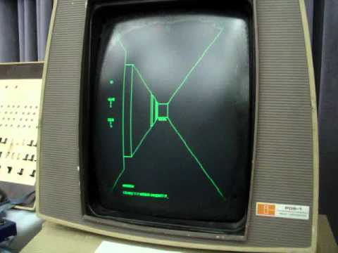
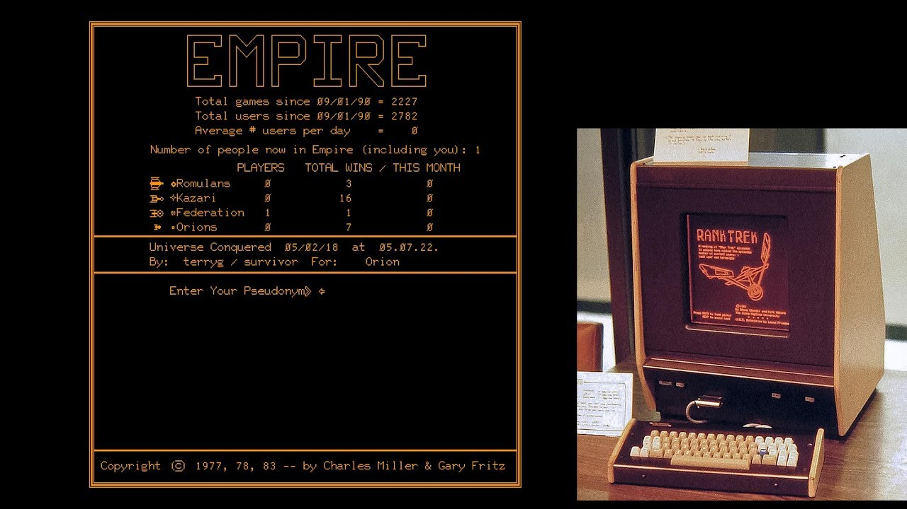
History

Slide 8
History

Slide 9
History

Slide 10
History

Slide 11
History

Slide 12
History

Slide 13
History

Slide 14
History
Notes:
World of Tanks Blitz

Slide 15
What to expect in general?
The obvious answer - more than one player
However, we need to consider modes of play
Turn-based games are multiplayer, but one player at a time, so they are easy to implement in various networking modes
e.g. Online chess, Drafts etc.
Simultaneous play requires more careful design
All players need to be updated in some way
Delays in the network can affect play, so limitations on game speed, types of interactions, number of players etc.
Generally, careful design, reduction of data that must be shared, clever networking and even a little psychology can be used to improve multi-player experience
o e.g. in-app animations distract the user – can allow time for network updates

Slide 16
Multiplayer Strategies
Two basic strategies
all data stored on a central server, all players need to access server to determine current game state, updates requested by clients
core player data stored on player’s machine, and necessary bits sent to all other players
This can get complex, if, for example, a player needs to let all other players know her position or status (since all other players need to do the same)
There is a third alternative
Use both strategies, directing each to the most appropriate task
e.g. in a given locale, player positions, shots taken etc. need to be handled in real-time - use direct network connections (web-sockets for Web Apps)
Players in other locales, player appearance (avatars) etc. the data is not so crucial - can use a central server

Slide 17
Case Study: Starsiege: Tribes
https://www.theringer.com/2018/12/5/18126162/starsiege-tribes-anniversary-first-person-shooters-fortnite-influence

Slide 18
Case Study: Starsiege: Tribes
1. Non-guaranteed data. As one might expect, this is data that the game designates as nonessential to the game. When bandwidth-starved, the game can choose to drop this data first.
2. Guaranteed data. This data guarantees both arrival and ordering of the data in question. This is used for data deemed critical by the game, such as an event signifying when a player has fired a weapon.
3. “Most recent state” data. This type of data is for cases where only the most recent version of the data is of importance. One example is the hit points of a particular player. A player’s hit points 5 seconds ago are not terribly relevant if the game knows what their hit points are right now.
4. Guaranteed quickest data. This data is given the highest priority in order to transmit as quickly as possible with guaranteed delivery. An example of this type of data is player movement information, which is typically relevant for a very short period of time, and thus should be transmitted quickly.

Slide 19
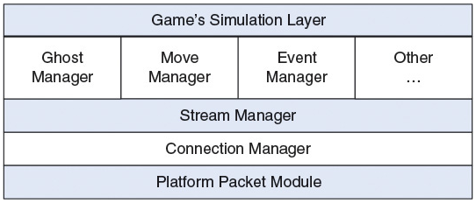
Case Study: Starsiege: Tribes

Slide 20
Case Study: Age of Empires

